Slide 1
RUSTikales Rust for beginners
©Philippe Felix Haupt 2023

Slide 2
Plan for today
©Philippe Felix Haupt 2023

Slide 3
Plan for today
Recap
©Philippe Felix Haupt 2023

Slide 4
Plan for today
Recap
Functions
©Philippe Felix Haupt 2023

Slide 5
Plan for today
Recap
Functions
Calling functions
©Philippe Felix Haupt 2023

Slide 6
Plan for today
Recap
Functions
Calling functions
Recursion
©Philippe Felix Haupt 2023

Slide 7
Plan for today
Recap
Functions
Calling functions
Recursion
Ownership
©Philippe Felix Haupt 2023

Slide 8
Recap
©Philippe Felix Haupt 2023

Slide 9
Recap
Primitive Types in Rust: i8, u8, …, i128, u128, bool, f32, f64
©Philippe Felix Haupt 2023

Slide 10
Recap
Primitive Types in Rust: i8, u8, …, i128, u128, bool, f32, f64
Ownership-Model
Borrowing
Borrow Checker
©Philippe Felix Haupt 2023

Slide 11
Recap
Primitive Types in Rust: i8, u8, …, i128, u128, bool, f32, f64
Ownership-Model
Borrowing
Borrow Checker
Functions are declared using the keyword fn
Functions can take in Parameters:
are almost identical to normal variables
define how you call the function
Functions can have a Return type:
If declared, all return statements need to return a value of the given type
©Philippe Felix Haupt 2023

Slide 12
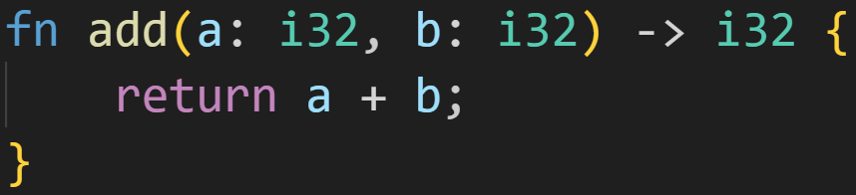
Recap
A function may look like this:
©Philippe Felix Haupt 2023

Slide 13
Recap
A function may look like this:
Parameters
©Philippe Felix Haupt 2023

Slide 14
Recap
A function may look like this:
Parameters
Return Type
©Philippe Felix Haupt 2023

Slide 15
Recap
A function may look like this:
Parameters
Return Type
Return statement
©Philippe Felix Haupt 2023

Slide 16
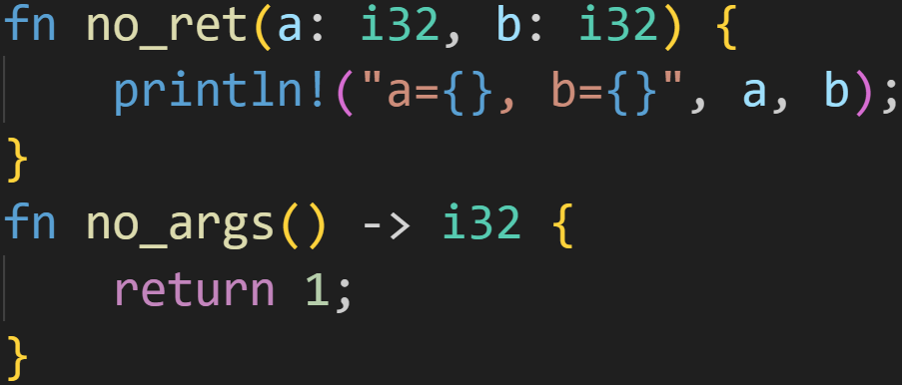
Recap
A function may look like this:
©Philippe Felix Haupt 2023

Slide 17
Recap
Return Type is optional
A function may look like this:
©Philippe Felix Haupt 2023

Slide 18
Recap
Return Type is optional
A function may look like this:
Parameters are optional
©Philippe Felix Haupt 2023

Slide 19
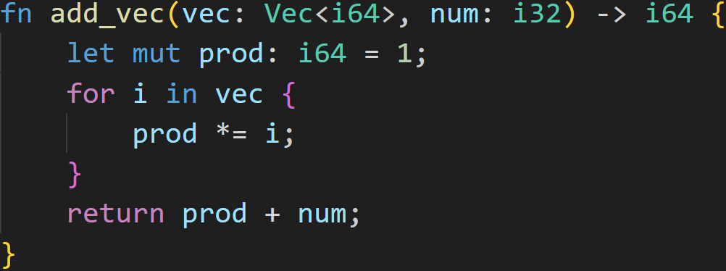
Recap
1/3
A function may look like this:
©Philippe Felix Haupt 2023

Slide 20
Recap
Does this function compile?
1/3
A function may look like this:
©Philippe Felix Haupt 2023

Slide 21
Recap
Does this function compile?
1/3
A function may look like this:
`prod` is i64
©Philippe Felix Haupt 2023

Slide 22
Recap
Does this function compile?
1/3
A function may look like this:
`prod` is i64
©Philippe Felix Haupt 2023

Slide 23
Recap
Does this function compile?
1/3
A function may look like this:
`prod` is i64
`num` is i32
©Philippe Felix Haupt 2023

Slide 24
Recap
Does this function compile?
1/3
A function may look like this:
`prod` is i64
`num` is i32
Can’t add i32 and i64 together :)
©Philippe Felix Haupt 2023

Slide 25
Functions - Calling functions
Declaring functions is one thing, but calling them is where the fun begins
©Philippe Felix Haupt 2023

Slide 26
Functions - Calling functions
Declaring functions is one thing, but calling them is where the fun begins
Calling a function is pretty simple:
Similar syntax to function declaration
©Philippe Felix Haupt 2023

Slide 27
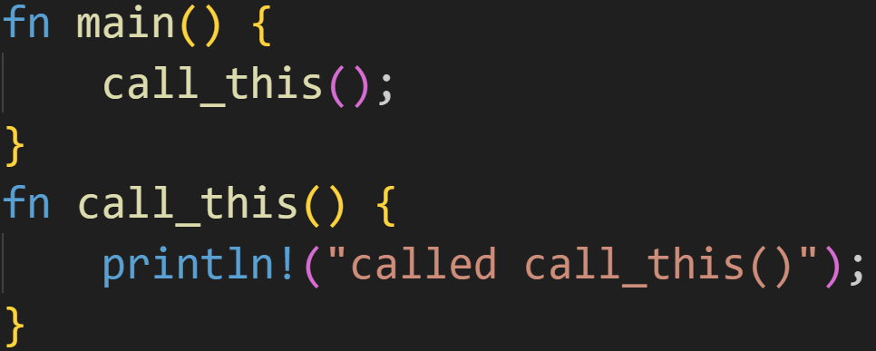
Functions - Calling functions
Declaring functions is one thing, but calling them is where the fun begins
Calling a function is pretty simple:
Similar syntax to function declaration
©Philippe Felix Haupt 2023

Slide 28
Functions - Calling functions
Declaring functions is one thing, but calling them is where the fun begins
Calling a function is pretty simple:
Similar syntax to function declaration
Function declaration
©Philippe Felix Haupt 2023

Slide 29
Functions - Calling functions
Declaring functions is one thing, but calling them is where the fun begins
Calling a function is pretty simple:
Similar syntax to function declaration
Calling the function
©Philippe Felix Haupt 2023

Slide 30
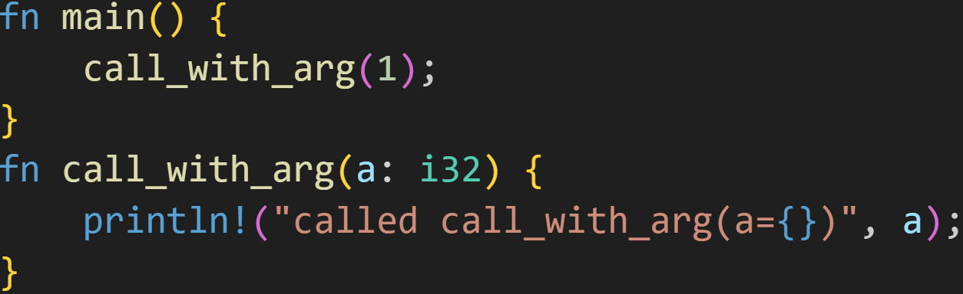
Functions - Calling functions
Declaring functions is one thing, but calling them is where the fun begins
Calling a function is pretty simple:
Similar syntax to function declaration
©Philippe Felix Haupt 2023

Slide 31
Functions - Calling functions
Declaring functions is one thing, but calling them is where the fun begins
Calling a function is pretty simple:
Similar syntax to function declaration
Function declaration
©Philippe Felix Haupt 2023

Slide 32
Functions - Calling functions
Declaring functions is one thing, but calling them is where the fun begins
Calling a function is pretty simple:
Similar syntax to function declaration
Calling the function
©Philippe Felix Haupt 2023

Slide 33
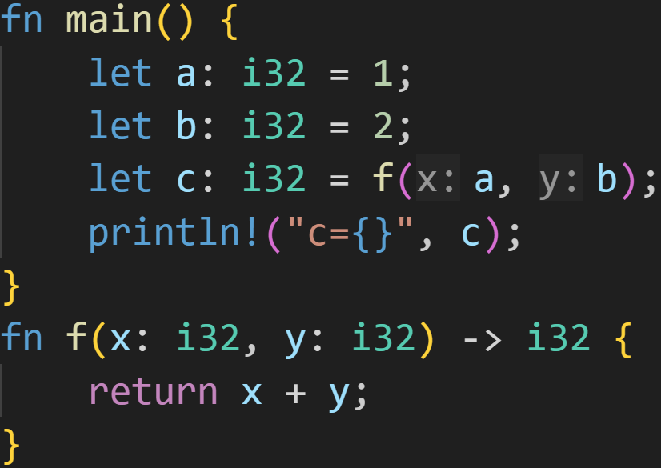
Functions - Calling functions
©Philippe Felix Haupt 2023

Slide 34
Functions - Calling functions
Function declared to take 2 parameters
©Philippe Felix Haupt 2023

Slide 35
Functions - Calling functions
Pass 2 arguments here
Function declared to take 2 parameters
©Philippe Felix Haupt 2023

Slide 36
Functions - Calling functions
Function declared to return i32
©Philippe Felix Haupt 2023

Slide 37
Functions - Calling functions
f(a,b) evaluates to an i32
Function declared to return i32
©Philippe Felix Haupt 2023

Slide 38
Functions - Calling functions
Expected i32
f(a,b) evaluates to an i32
Function declared to return i32
©Philippe Felix Haupt 2023

Slide 39
Intermission - But how?
©Philippe Felix Haupt 2023

Slide 40
Intermission - But how?
How does x get the value of a? How does y get the value of b?
©Philippe Felix Haupt 2023

Slide 41
Intermission - But how?
How does x get the value of a? How does y get the value of b?
How does the computer even get here?
©Philippe Felix Haupt 2023

Slide 42
Intermission - But how?
How does x get the value of a? How does y get the value of b?
How does the computer even get here?
What does returning even mean?
©Philippe Felix Haupt 2023

Slide 43
Intermission - Control Flow, again
©Philippe Felix Haupt 2023

Slide 44
Intermission - Control Flow, again
We’ve already seen ways of controlling the flow of a program, functions are another way
©Philippe Felix Haupt 2023

Slide 45
Intermission - Control Flow, again
We’ve already seen ways of controlling the flow of a program, functions are another way
Whenever the computer sees a function, it jumps there
©Philippe Felix Haupt 2023

Slide 46
Intermission - Control Flow, again
We’ve already seen ways of controlling the flow of a program, functions are another way
Whenever the computer sees a function, it jumps there
Every function gets its own stack frame
Stack is a region of memory
Place for parameters and variables
©Philippe Felix Haupt 2023

Slide 47
Intermission - Control Flow, again
We’ve already seen ways of controlling the flow of a program, functions are another way
Whenever the computer sees a function, it jumps there
Every function gets its own stack frame
Stack is a region of memory
Place for parameters and variables
Every time you call a function, you allocate more stack, which is freed when you leave the function
©Philippe Felix Haupt 2023

Slide 48
Intermission - Control Flow, again
We’ve already seen ways of controlling the flow of a program, functions are another way
Whenever the computer sees a function, it jumps there
Every function gets its own stack frame
Stack is a region of memory
Place for parameters and variables
Every time you call a function, you allocate more stack, which is freed when you leave the function
This is where the name Stack Overflow comes from, you run out of stack memory and the program crashes :)
©Philippe Felix Haupt 2023

Slide 49
Intermission - Control Flow, again
Variable | Value
©Philippe Felix Haupt 2023

Slide 50
Intermission - Control Flow, again
Variable | Value
a: i32 | ???
b: i32 | ???
c: i32 | ???
©Philippe Felix Haupt 2023

Slide 51
Intermission - Control Flow, again
Variable | Value
a: i32 | 1
b: i32 | ???
c: i32 | ???
©Philippe Felix Haupt 2023

Slide 52
Intermission - Control Flow, again
Variable | Value
a: i32 | 1
b: i32 | 2
c: i32 | ???
©Philippe Felix Haupt 2023

Slide 53
Intermission - Control Flow, again
Variable | Value
a: i32 | 1
b: i32 | 2
c: i32 | ???
We want to jump to `f`, and run its code, but we need to pass the arguments. But we can’t assign to `x` and `y` yet, there is no stack memory for them!
©Philippe Felix Haupt 2023

Slide 54
Intermission - Control Flow, again
Variable | Value
a: i32 | 1
b: i32 | 2
c: i32 | ???
We want to jump to `f`, and run its code, but we need to pass the arguments. But we can’t assign to `x` and `y` yet, there is no stack memory for them!
Solution: We use the registers our CPU offers
Register 1 | ???
Register 2 | ???
©Philippe Felix Haupt 2023

Slide 55
Intermission - Control Flow, again
Variable | Value
a: i32 | 1
b: i32 | 2
c: i32 | ???
Argument 1
Register 1 | 1
Register 2 | ???
©Philippe Felix Haupt 2023

Slide 56
Intermission - Control Flow, again
Variable | Value
a: i32 | 1
b: i32 | 2
c: i32 | ???
Argument 2
Register 1 | 1
Register 2 | 2
©Philippe Felix Haupt 2023

Slide 57
Intermission - Control Flow, again
Variable | Value
a: i32 | 1
b: i32 | 2
c: i32 | ???
x: i32 | ???
y: i32 | ???
main-stack
f-stack
Register 1 | 1
Register 2 | 2
©Philippe Felix Haupt 2023

Slide 58
Intermission - Control Flow, again
Variable | Value
a: i32 | 1
b: i32 | 2
c: i32 | ???
x: i32 | ???
y: i32 | ???
Now we have x and y, we can move the values back!
Register 1 | 1
Register 2 | 2
©Philippe Felix Haupt 2023

Slide 59
Intermission - Control Flow, again
Variable | Value
a: i32 | 1
b: i32 | 2
c: i32 | ???
x: i32 | 1
y: i32 | ???
Parameter 1
Register 1 | 1
Register 2 | 2
©Philippe Felix Haupt 2023

Slide 60
Intermission - Control Flow, again
Variable | Value
a: i32 | 1
b: i32 | 2
c: i32 | ???
x: i32 | 1
y: i32 | 2
Parameter 2
Register 1 | 1
Register 2 | 2
©Philippe Felix Haupt 2023

Slide 61
Intermission - Control Flow, again
Variable | Value
a: i32 | 1
b: i32 | 2
c: i32 | ???
x: i32 | 1
y: i32 | 2
Now there’s a similar problem: `f` can’t store the result in `c`, because it is defined in main! Where do we store the return value??
©Philippe Felix Haupt 2023

Slide 62
Intermission - Control Flow, again
Variable | Value
a: i32 | 1
b: i32 | 2
c: i32 | ???
x: i32 | 1
y: i32 | 2
Yep, in a register :)
Register 1 | 1
Register 2 | 2
©Philippe Felix Haupt 2023

Slide 63
Intermission - Control Flow, again
Variable | Value
a: i32 | 1
b: i32 | 2
c: i32 | ???
x: i32 | 1
y: i32 | 2
Yep, in a register :)
Register 1 | 3
Register 2 | 2
1 + 2 = 3
©Philippe Felix Haupt 2023

Slide 64
Intermission - Control Flow, again
Variable | Value
a: i32 | 1
b: i32 | 2
c: i32 | ???
We left `f`, the stack is freed
Register 1 | 3
Register 2 | 2
©Philippe Felix Haupt 2023

Slide 65
Intermission - Control Flow, again
Variable | Value
a: i32 | 1
b: i32 | 2
c: i32 | 3
Return Value
Register 1 | 3
Register 2 | 2
©Philippe Felix Haupt 2023

Slide 66

Intermission - Control Flow, again
Variable | Value
a: i32 | 1
b: i32 | 2
c: i32 | 3
The output is:
©Philippe Felix Haupt 2023

Slide 67
Intermission - Control Flow, again
Variable | Value
©Philippe Felix Haupt 2023

Slide 68
Functions - Calling functions
When calling a function, you always need to provide all arguments
©Philippe Felix Haupt 2023

Slide 69
Functions - Calling functions
When calling a function, you always need to provide all arguments
Every argument needs to match its respective parameter type
©Philippe Felix Haupt 2023

Slide 70
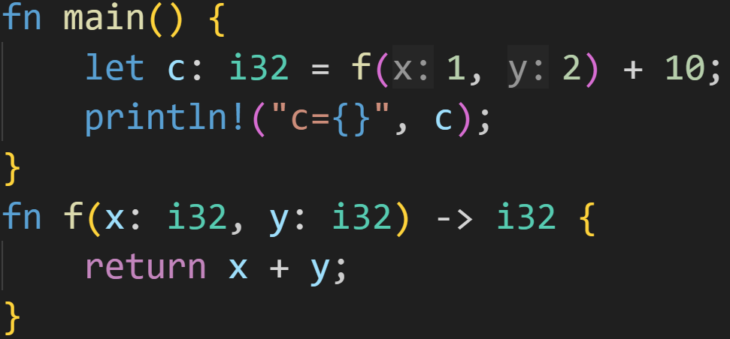
Functions - Calling functions
When calling a function, you always need to provide all arguments
Every argument needs to match its respective parameter type
You can treat function calls as any other expression:
©Philippe Felix Haupt 2023

Slide 71
Functions - Calling functions
When calling a function, you always need to provide all arguments
Every argument needs to match its respective parameter type
You can treat function calls as any other expression:
because `f` returns an i32, you can also add to that
©Philippe Felix Haupt 2023

Slide 72
Functions - Calling functions
When calling a function, you always need to provide all arguments
Every argument needs to match its respective parameter type
You can treat function calls as any other expression:
because `f` returns an i32, you can also add to that
prints c=13
©Philippe Felix Haupt 2023

Slide 73
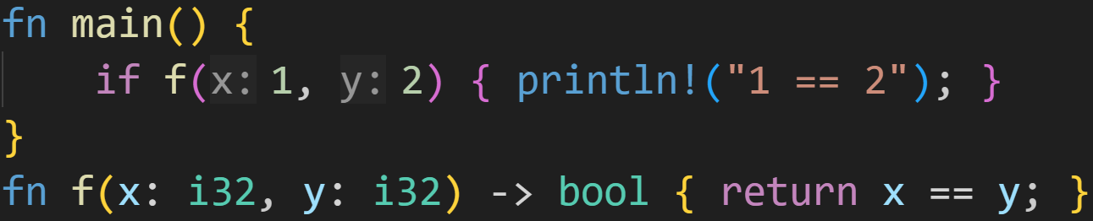
Functions - Calling functions
When calling a function, you always need to provide all arguments
Every argument needs to match its respective parameter type
You can treat function calls as any other expression:
©Philippe Felix Haupt 2023

Slide 74
Functions - Calling functions
When calling a function, you always need to provide all arguments
Every argument needs to match its respective parameter type
You can treat function calls as any other expression:
because `f` returns a boolean, you can use it in an if-statement
©Philippe Felix Haupt 2023

Slide 75
Functions - Calling functions
When calling a function, you always need to provide all arguments
Every argument needs to match its respective parameter type
You can treat function calls as any other expression:
1/3
Does this print anything?
©Philippe Felix Haupt 2023

Slide 76
Functions - Calling functions
When calling a function, you always need to provide all arguments
Every argument needs to match its respective parameter type
You can treat function calls as any other expression:
1/3
Does this print anything?
Nope, f(1, 2) returns false :)
©Philippe Felix Haupt 2023

Slide 77
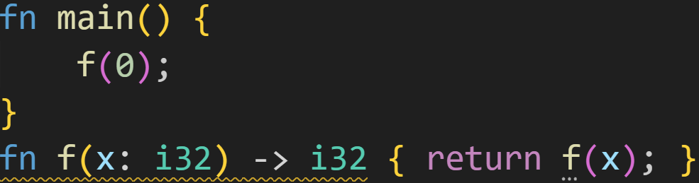
Functions - Recursion
You can treat function calls as any other expression:
©Philippe Felix Haupt 2023

Slide 78
Functions - Recursion
You can treat function calls as any other expression:
You can call it in itself!
©Philippe Felix Haupt 2023

Slide 79
Functions - Recursion
You can treat function calls as any other expression:
Rust does not like this function :^)
©Philippe Felix Haupt 2023

Slide 80
Functions - Recursion
You can treat function calls as any other expression:
Yeah…
Rust does not like this function :^)
©Philippe Felix Haupt 2023

Slide 81
Functions - Recursion
You can treat function calls as any other expression:
Yeah…
Every time we call `f`, we push at least 4 bytes for `x` on the stack
Rust does not like this function :^)
©Philippe Felix Haupt 2023

Slide 82
Functions - Recursion
Everything we’ve done so far (if-statements, loops, etc) was iterative: We start with an input, we do some steps, we finish
©Philippe Felix Haupt 2023

Slide 83
Functions - Recursion
Everything we’ve done so far (if-statements, loops, etc) was iterative: We start with an input, we do some steps, we finish
Most problems can be solved like that, using only nested loops
©Philippe Felix Haupt 2023

Slide 84
Functions - Recursion
Everything we’ve done so far (if-statements, loops, etc) was iterative: We start with an input, we do some steps, we finish
Most problems can be solved like that, using only nested loops
Some problems are easier to solve recursively: You start with an input, split it into smaller parts, and solve those parts, calling the function you started with, inside itself
©Philippe Felix Haupt 2023

Slide 85
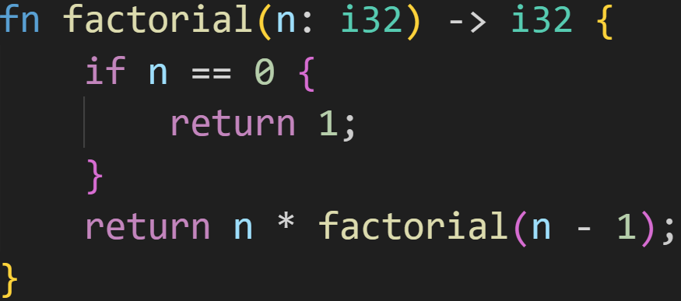
Functions - Recursion
Recursion might look like this:
©Philippe Felix Haupt 2023

Slide 86
Functions - Recursion
Recursion might look like this:
Base case
©Philippe Felix Haupt 2023

Slide 87
Functions - Recursion
Recursion might look like this:
Calling the function inside itself
©Philippe Felix Haupt 2023

Slide 88
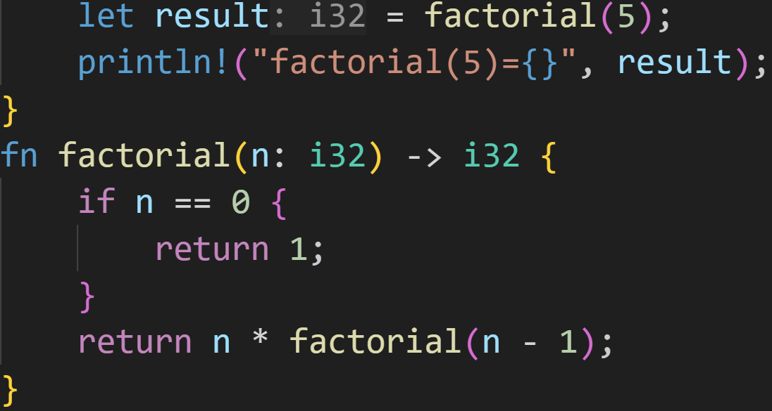
Functions - Recursion
Register | Value
Ret | ???
Arg | 5
Recursion might look like this:
Variable | Value
result | ???
©Philippe Felix Haupt 2023

Slide 89
Functions - Recursion
Register | Value
Ret | ???
Arg | 5
Recursion might look like this:
Variable | Value
result | ???
n | 5
©Philippe Felix Haupt 2023

Slide 90
Functions - Recursion
Register | Value
Ret | ???
Arg | 4
Recursion might look like this:
Variable | Value
result | ???
n | 5
false
©Philippe Felix Haupt 2023

Slide 91
Functions - Recursion
Register | Value
Ret | ???
Arg | 4
Recursion might look like this:
Variable | Value
result | ???
n | 5
n | 4
Each time you call a function, you get new stack space! All `n`s here are different variables in memory!
©Philippe Felix Haupt 2023

Slide 92
Functions - Recursion
Register | Value
Ret | ???
Arg | 3
Recursion might look like this:
Variable | Value
result | ???
n | 5
n | 4
false
©Philippe Felix Haupt 2023

Slide 93
Functions - Recursion
Register | Value
Ret | ???
Arg | 3
Recursion might look like this:
Variable | Value
result | ???
n | 5
n | 4
n | 3
©Philippe Felix Haupt 2023

Slide 94
Functions - Recursion
Register | Value
Ret | ???
Arg | 0
Recursion might look like this:
Variable | Value
result | ???
n | 5
n | 4
n | 3
n | 2
n | 1
n | 0
Much later…
©Philippe Felix Haupt 2023

Slide 95
Functions - Recursion
Register | Value
Ret | 1
Arg | 0
Recursion might look like this:
Variable | Value
result | ???
n | 5
n | 4
n | 3
n | 2
n | 1
true!!!
©Philippe Felix Haupt 2023

Slide 96
Functions - Recursion
Register | Value
Ret | 1
Arg | 0
Recursion might look like this:
Variable | Value
result | ???
n | 5
n | 4
n | 3
n | 2
n | 1
Ret = n * Ret
©Philippe Felix Haupt 2023

Slide 97
Functions - Recursion
Register | Value
Ret | 1
Arg | 0
Recursion might look like this:
Variable | Value
result | ???
n | 5
n | 4
n | 3
n | 2
Ret = n * Ret
©Philippe Felix Haupt 2023

Slide 98
Functions - Recursion
Register | Value
Ret | 2
Arg | 0
Recursion might look like this:
Variable | Value
result | ???
n | 5
n | 4
n | 3
Ret = n * Ret
©Philippe Felix Haupt 2023

Slide 99
Functions - Recursion
Register | Value
Ret | 6
Arg | 0
Recursion might look like this:
Variable | Value
result | ???
n | 5
n | 4
Ret = n * Ret
©Philippe Felix Haupt 2023

Slide 100
Functions - Recursion
Register | Value
Ret | 24
Arg | 0
Recursion might look like this:
Variable | Value
result | ???
n | 5
Ret = n * Ret
©Philippe Felix Haupt 2023

Slide 101
Functions - Recursion
Register | Value
Ret | 120
Arg | 0
Recursion might look like this:
Variable | Value
result | ???
Ret = n * Ret
©Philippe Felix Haupt 2023

Slide 102
Functions - Recursion
Register | Value
Ret | 120
Arg | 0
Recursion might look like this:
Variable | Value
result | ???
According to the stack, we’re done with factorial recursion, return goes back to main
©Philippe Felix Haupt 2023

Slide 103
Functions - Recursion
Register | Value
Ret | 120
Arg | 0
Recursion might look like this:
Variable | Value
result | 120
©Philippe Felix Haupt 2023

Slide 104

Functions - Recursion
Register | Value
Ret | 120
Arg | 0
Recursion might look like this:
Variable | Value
result | 120
©Philippe Felix Haupt 2023

Slide 105
Functions - Recursion
Register | Value
Ret | 120
Arg | 0
Recursion might look like this:
Variable | Value
©Philippe Felix Haupt 2023

Slide 106
Functions - Recursion
In general, Recursive and Iterative algorithms are equally powerful:
Every recursive algorithm can be rewritten using loops
Every iterative algorithm can be rewritten using recursion
©Philippe Felix Haupt 2023

Slide 107
Functions - Recursion
In general, Recursive and Iterative algorithms are equally powerful:
Every recursive algorithm can be rewritten using loops
Every iterative algorithm can be rewritten using recursion
Recursion comes with Overhead, usually Iteration is faster
©Philippe Felix Haupt 2023

Slide 108
Functions - Recursion
In general, Recursive and Iterative algorithms are equally powerful:
Every recursive algorithm can be rewritten using loops
Every iterative algorithm can be rewritten using recursion
Recursion comes with Overhead, usually Iteration is faster
Some problems exist where Recursion makes more sense
Breaking large problems into smaller problems is very often a useful trick
Walking a recursively defined data structure, like Trees
©Philippe Felix Haupt 2023

Slide 109
Functions - Recursion
In general, Recursive and Iterative algorithms are equally powerful:
Every recursive algorithm can be rewritten using loops
Every iterative algorithm can be rewritten using recursion
Recursion comes with Overhead, usually Iteration is faster
Some problems exist where Recursion makes more sense
Breaking large problems into smaller problems is very often a useful trick
Walking a recursively defined data structure, like Trees
You’ll learn the nuances over time, and in modules such as AuD, Prog and TheoLog :)
Enough theory for today, back to Rust :)
©Philippe Felix Haupt 2023

Slide 110
Functions - Ownership
As stated a million times before, parameters are normal variables
©Philippe Felix Haupt 2023

Slide 111
Functions - Ownership
As stated a million times before, parameters are normal variables
This means that normal Ownership and Borrow Checker rules apply to them as well
©Philippe Felix Haupt 2023

Slide 112
Functions - Ownership
As stated a million times before, parameters are normal variables
This means that normal Ownership and Borrow Checker rules apply to them as well
More notably, it applies to arguments passed into functions
©Philippe Felix Haupt 2023

Slide 113
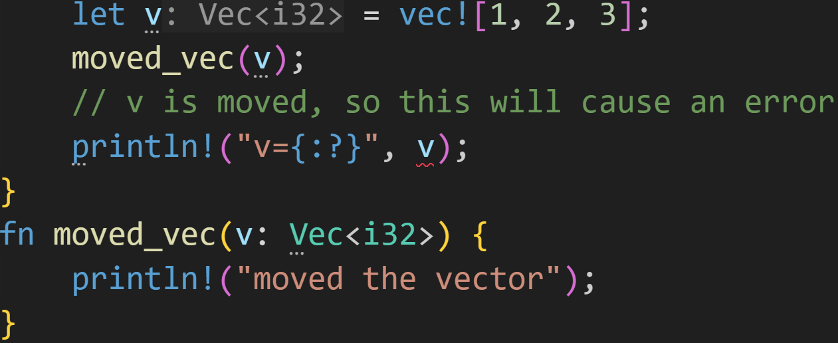
Functions - Ownership
As stated a million times before, parameters are normal variables
This means that normal Ownership rules apply to them as well
More notably, it applies to arguments passed into functions
©Philippe Felix Haupt 2023

Slide 114
Functions - Ownership
As stated a million times before, parameters are normal variables
This means that normal Ownership rules apply to them as well
More notably, it applies to arguments passed into functions
This moves the vector `v`!
©Philippe Felix Haupt 2023

Slide 115
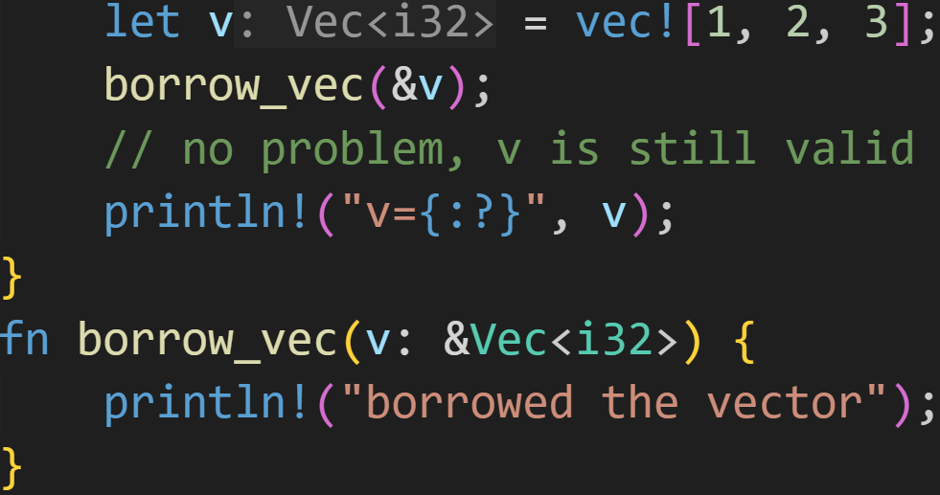
Functions - Ownership
As stated a million times before, parameters are normal variables
This means that normal Ownership rules apply to them as well
More notably, it applies to arguments passed into functions
But we can borrow it, and everything is fine!
©Philippe Felix Haupt 2023

Slide 116
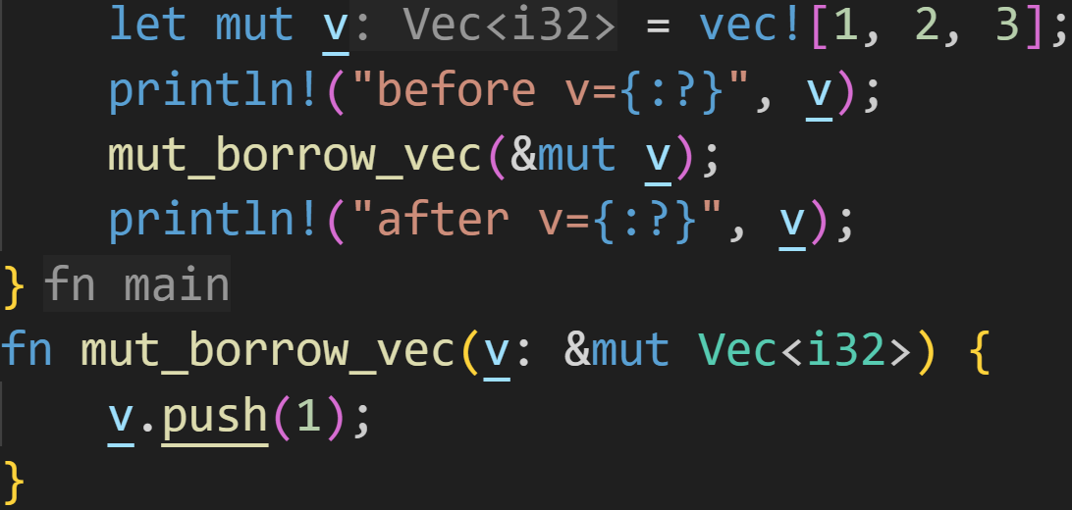
Functions - Ownership
Similarly, we can also pass mutable references:
©Philippe Felix Haupt 2023

Slide 117
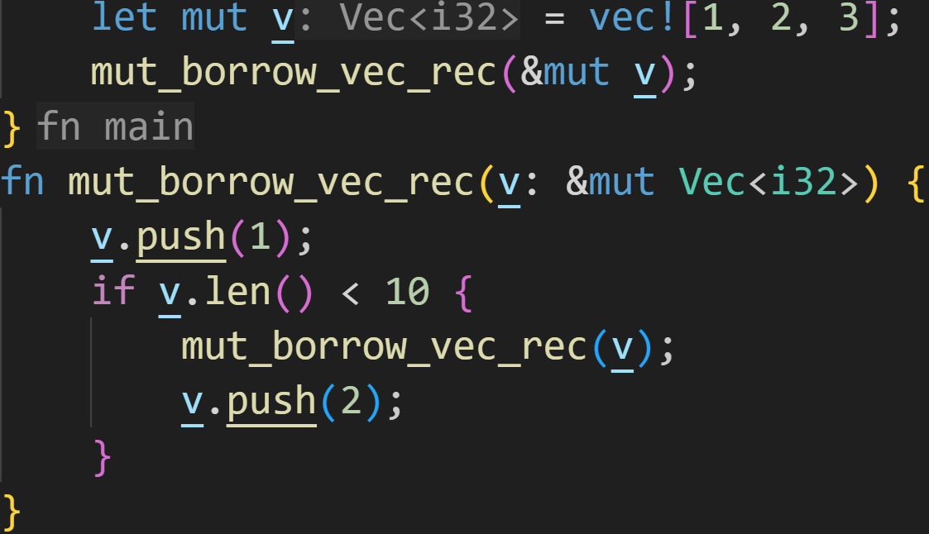
Functions - Ownership
Similarly, we can also pass mutable references, even recursively:
©Philippe Felix Haupt 2023

Slide 118

Functions - Ownership
Similarly, we can also pass mutable references, even recursively:
What?
©Philippe Felix Haupt 2023

Slide 119
Functions - Ownership
Similarly, we can also pass mutable references, even recursively:
lifetime of &mut v
We’re using the same reference the whole time, we’re only borrowing once!
©Philippe Felix Haupt 2023

Slide 120
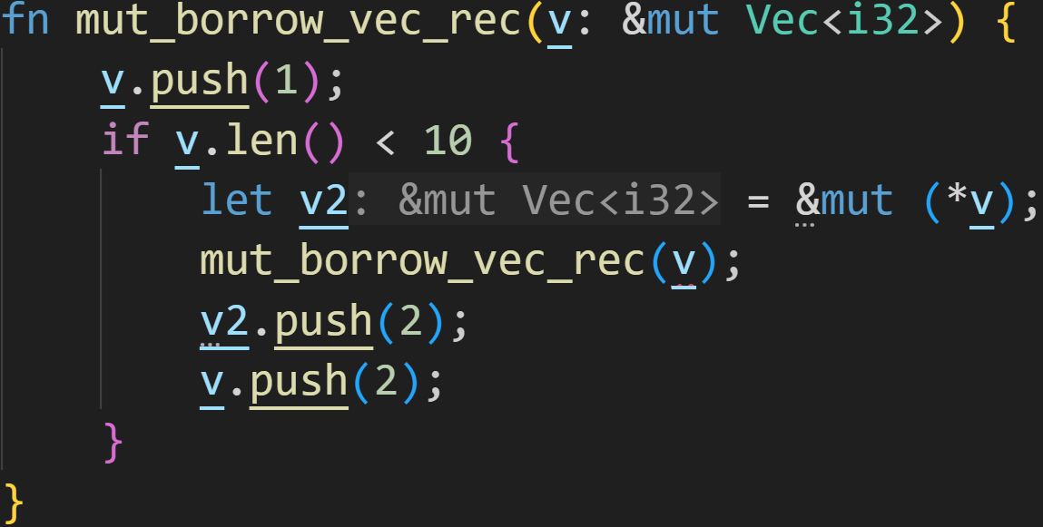
Functions - Ownership
Similarly, we can also pass mutable references, even recursively:
Another mutable borrow of the original variable
©Philippe Felix Haupt 2023

Slide 121
Functions - Ownership
Similarly, we can also pass mutable references, even recursively:
Borrow Checker says no!
©Philippe Felix Haupt 2023

Slide 122
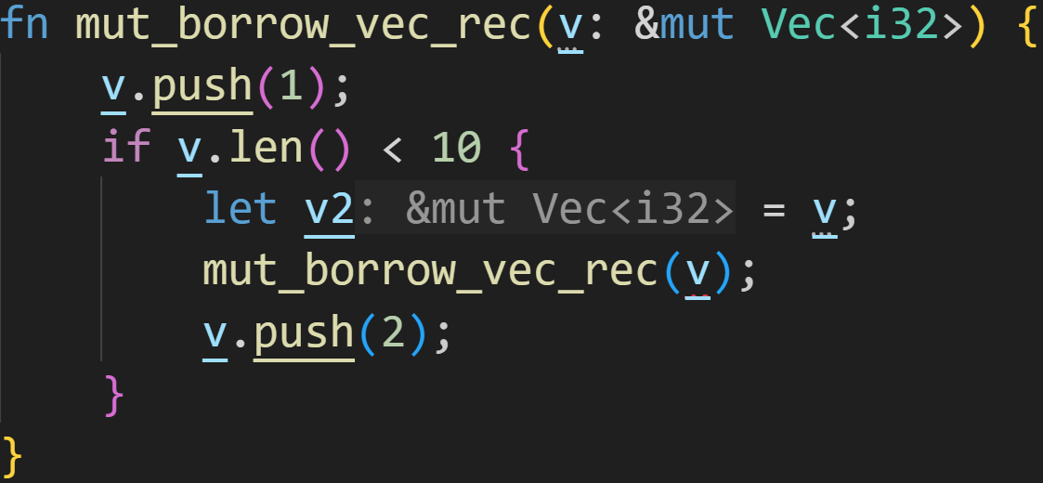
Functions - Ownership
Similarly, we can also pass mutable references, even recursively:
&mut Vec<i32> does not implement the Copy trait, so this is moved
©Philippe Felix Haupt 2023

Slide 123
Functions - Ownership
Similarly, we can also pass mutable references, even recursively:
Can’t use moved value
©Philippe Felix Haupt 2023

Slide 124
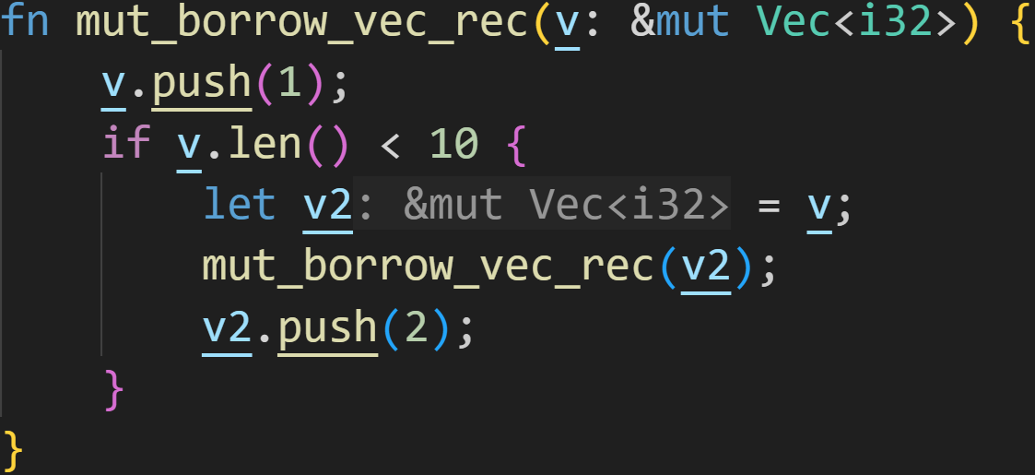
Functions - Ownership
Similarly, we can also pass mutable references, even recursively:
Using moved reference, everything is fine
©Philippe Felix Haupt 2023

Slide 125
Functions - Ownership
Passing references as arguments is fine, but can we also return references?
©Philippe Felix Haupt 2023

Slide 126
Functions - Ownership
Passing references as arguments is fine, but can we also return references?
Simple answer: No
Long answer: Only if the reference was passed as argument, and even then not always
©Philippe Felix Haupt 2023

Slide 127
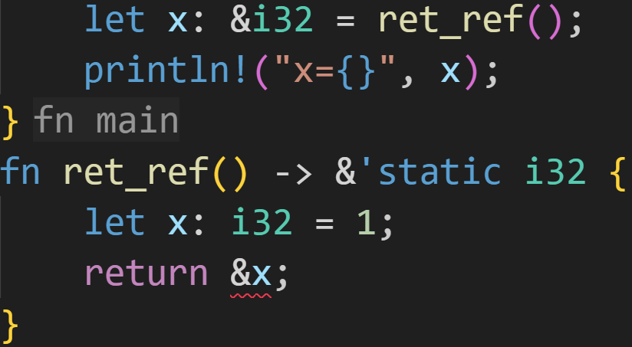
Functions - Ownership
Passing references as arguments is fine, but can we also return references?
©Philippe Felix Haupt 2023

Slide 128
Functions - Ownership
Passing references as arguments is fine, but can we also return references?
Lifetime specifier, tells the Compiler that the reference will live until the program exits
©Philippe Felix Haupt 2023

Slide 129
Functions - Ownership
Passing references as arguments is fine, but can we also return references?
2/3
Why does this cause a compiler error?
©Philippe Felix Haupt 2023

Slide 130
Functions - Ownership
Passing references as arguments is fine, but can we also return references?
2/3
Why does this cause a compiler error?
x lives on the Stack and will be freed at the end of ret_ref(), it does not live beyond the scope of the function → Dangling Reference
©Philippe Felix Haupt 2023

Slide 131
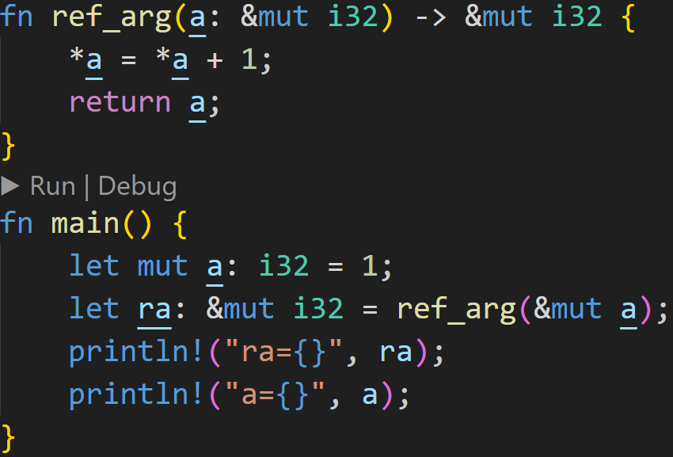
Functions - Ownership
©Philippe Felix Haupt 2023

Slide 132
Functions - Ownership
This is fine, we return a reference to something we don’t own
©Philippe Felix Haupt 2023

Slide 133
Functions - Ownership
This is fine, we return a reference to something we don’t own
`a` lives in main(), not in ref_arg(), so it outlives the function call
©Philippe Felix Haupt 2023

Slide 134
Functions - Ownership
This is fine, we return a reference to something we don’t own
`a` lives in main(), not in ref_arg(), so it outlives the function call
prints ra=2
prints a=2
©Philippe Felix Haupt 2023

Slide 135
Intermission - Exercise
Time for exercises!
©Philippe Felix Haupt 2023

Slide 136
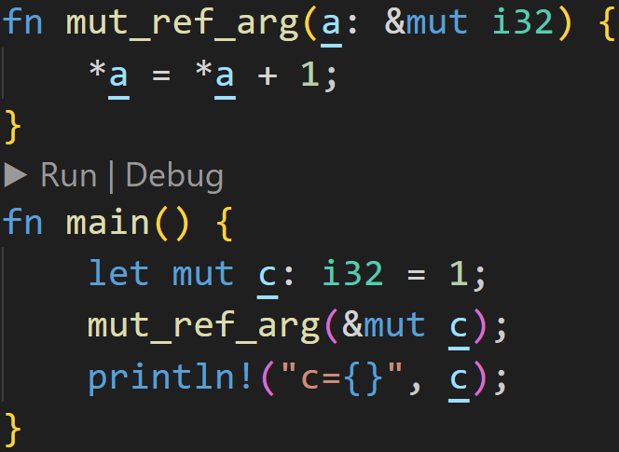
Intermission - Exercise
1/3
©Philippe Felix Haupt 2023

Slide 137
Intermission - Exercise
1/3
Does this compile? If yes, what does it print?
©Philippe Felix Haupt 2023

Slide 138
Intermission - Exercise
1/3
Does this compile? If yes, what does it print?
Yes, it does compile!
©Philippe Felix Haupt 2023

Slide 139
Intermission - Exercise
1/3
Does this compile? If yes, what does it print?
Yes, it does compile!
We modify the original `c`!
©Philippe Felix Haupt 2023

Slide 140

Intermission - Exercise
1/3
Does this compile? If yes, what does it print?
Yes, it does compile!
We modify the original `c`!
©Philippe Felix Haupt 2023

Slide 141
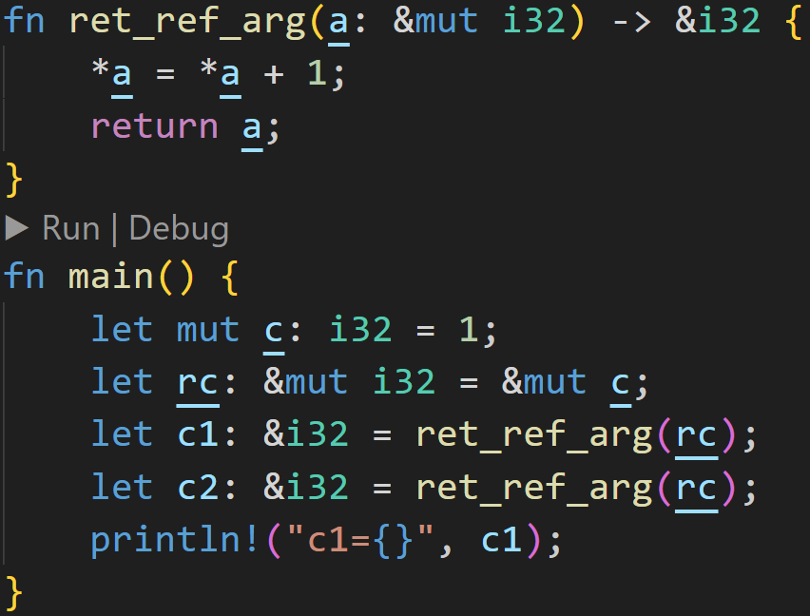
Intermission - Exercise
2/3
©Philippe Felix Haupt 2023

Slide 142
Intermission - Exercise
2/3
Does this compile? If yes, what does it print?
©Philippe Felix Haupt 2023

Slide 143
Intermission - Exercise
2/3
Does this compile? If yes, what does it print?
This is fine, Rust can downgrade from mutable borrows to immutable borrows
©Philippe Felix Haupt 2023

Slide 144
Intermission - Exercise
2/3
Does this compile? If yes, what does it print?
This is fine, Rust can downgrade from mutable borrows to immutable borrows
Lifetime of rc
©Philippe Felix Haupt 2023

Slide 145
Intermission - Exercise
2/3
Does this compile? If yes, what does it print?
This is fine, Rust can downgrade from mutable borrows to immutable borrows
Lifetime of rc
Lifetime of c1
©Philippe Felix Haupt 2023

Slide 146
Intermission - Exercise
2/3
Does this compile? If yes, what does it print?
This is fine, Rust can downgrade from mutable borrows to immutable borrows
Mutable
Immutable
Lifetime of rc
Lifetime of c1
©Philippe Felix Haupt 2023

Slide 147
Intermission - Exercise
2/3
Does this compile? If yes, what does it print?
This is fine, Rust can downgrade from mutable borrows to immutable borrows
Mutable
Immutable
Lifetime of rc
Lifetime of c1
Can’t borrow immutable when you’ve already borrowed mutable!
©Philippe Felix Haupt 2023

Slide 148
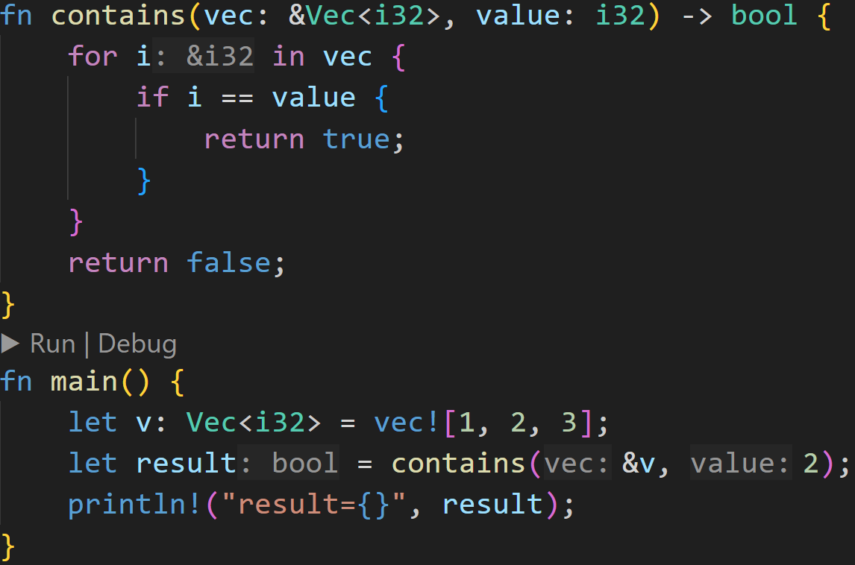
Intermission - Exercise
2/3
©Philippe Felix Haupt 2023

Slide 149
Intermission - Exercise
2/3
Does this compile? If yes, what does it print?
©Philippe Felix Haupt 2023

Slide 150
Intermission - Exercise
2/3
Does this compile? If yes, what does it print?
This code is almost perfect, there are no errors in the arguments or return values
©Philippe Felix Haupt 2023

Slide 151
Intermission - Exercise
2/3
Does this compile? If yes, what does it print?
BUT: &i32 == i32 is not implemented! The correct solution would’ve been *i == value
This code is almost perfect, there are no errors in the arguments or return values
©Philippe Felix Haupt 2023

Slide 152
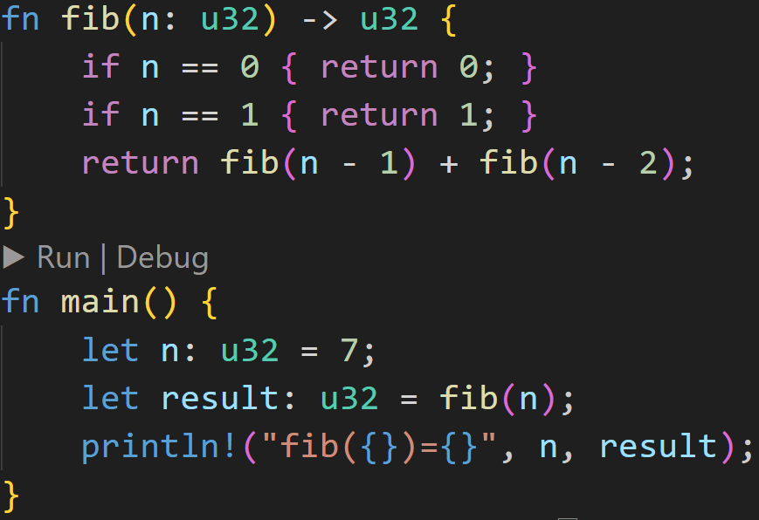
Intermission - Exercise
1/3
©Philippe Felix Haupt 2023

Slide 153
Intermission - Exercise
1/3
Does this compile? If yes, what does it print?
©Philippe Felix Haupt 2023

Slide 154
Intermission - Exercise
1/3
Does this compile? If yes, what does it print?
This code is very inefficient, but it gets the job done! It compiles!
©Philippe Felix Haupt 2023

Slide 155

Intermission - Exercise
1/3
Does this compile? If yes, what does it print?
This code is very inefficient, but it gets the job done! It compiles!
It successfully calculates fibonacci numbers, and prints:
©Philippe Felix Haupt 2023

Slide 156
Next time
Structs
Impl
©Philippe Felix Haupt 2023

